Slide 1

Design of a Fashion Retail Trend and
Seasonal Demand Visualization Platform
DSA0601-Data Handling and Visualization
PRESENTED BY
GUIDED BY
Dr S Senthilvadivu
A Roja [192424226]
M Arshini [192424322]
Akshaya R [192524118]

Slide 2


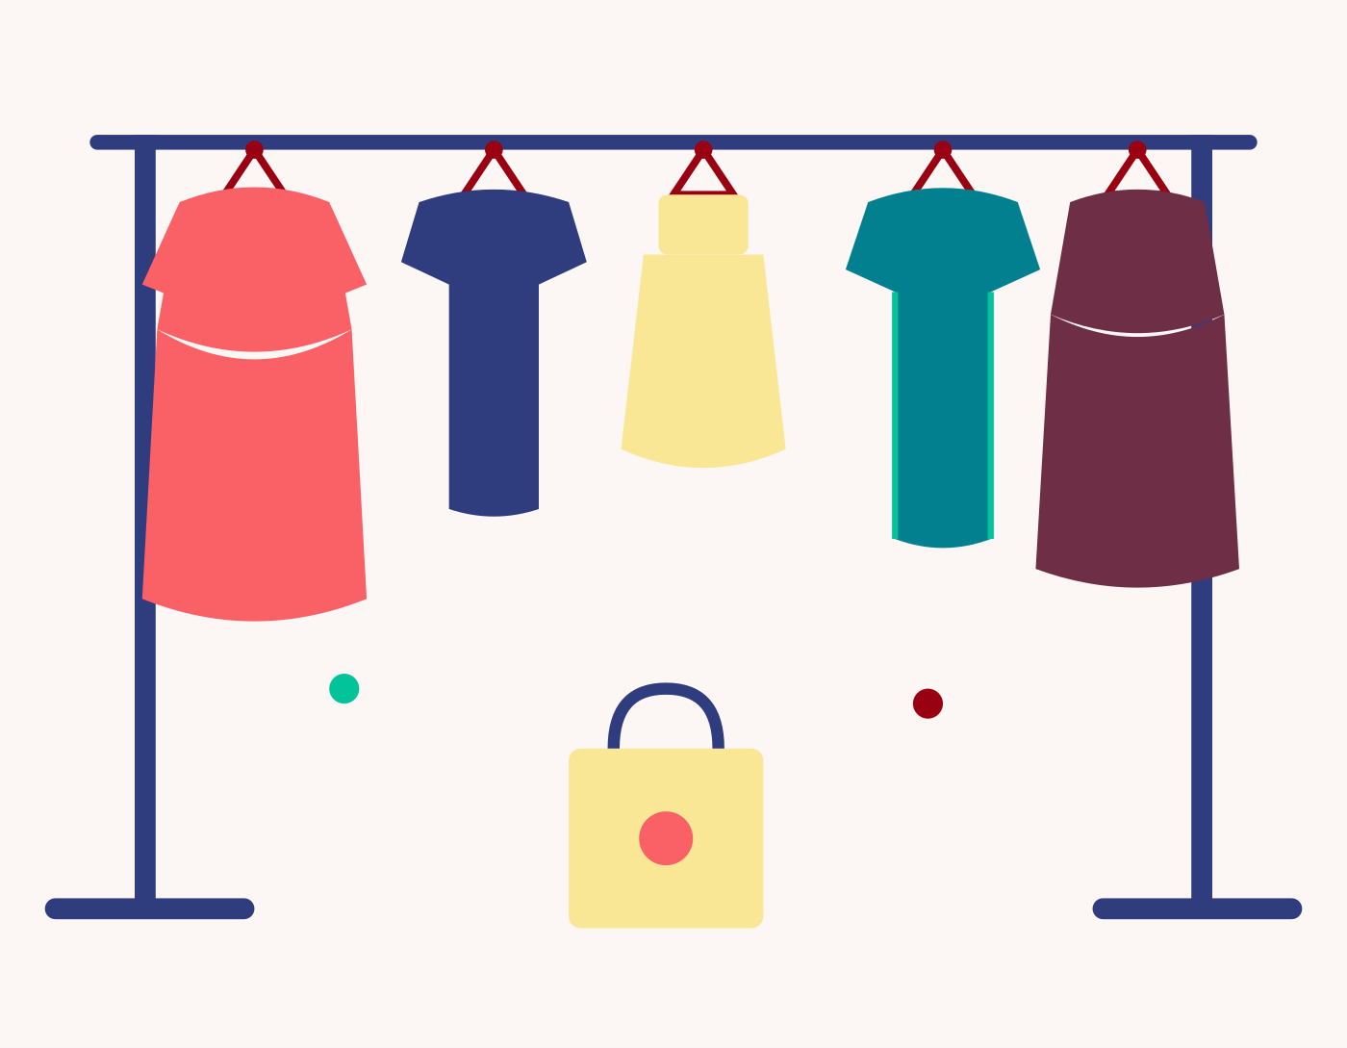
INTRODUCTION
Fashion retail generates large amounts of sales data from different products, categories, styles, seasons, prices, and customer preferences.
Customer demand changes according to seasons and fashion trends. Products that are popular in one season may have lower demand in another season.
Raw sales data is difficult to understand directly. Therefore, the data needs to be cleaned, organized, and categorized before analysis.
Data visualization helps us understand important patterns easily. Our project uses Violin Plots, Sunburst Charts, Time-Series Graphs, Moving Averages, and Bubble Charts.
Trend analysis and Moving Average techniques help us understand demand patterns over time and identify seasonal demand peaks and changes.
The final platform provides useful insights about categories, styles, seasonal demand, and price-popularity relationships, which can help retailers make better merchandising decisions.
Fashion retail: diverse, fast-changing product mix

Slide 3
PROBLEM STATEMENT
Fashion retailers have a large amount of sales data, but it is difficult to understand this data directly.
Seasonal demand changes from month to month, so retailers may find it difficult to know which products will be in high demand.
It is also difficult to understand which categories and styles are more popular.
The relationship between product price and popularity is not always clear.
Without proper analysis, retailers may face problems in planning their stock and making merchandising decisions.
Therefore, our project aims to analyze and visualize fashion sales data to identify seasonal demand, popular styles, sales trends, and price-popularity relationships.

Slide 4
OBJECTIVES
To collect and clean fashion retail sales data using Power Bi.
To categorize the data based on category, style, and season.
To analyze seasonal sales distribution using Violin Plots.
To visualize category and style proportions using Sunburst Charts.
To analyze monthly sales trends and forecast demand using Time-Series and Moving Average techniques.
To study the relationship between product price and popularity using Bubble Charts.
To provide useful visual insights that can help retailers make better merchandising decisions.
Tools and Technologies Used
Tools:
Power BI
Power Query
Microsoft Excel / CSV
Technologies:
DAX (Data Analysis Expressions) for calculated measures
Data Cleaning & Transformation
Data Visualization
Time-Series Analysis
Moving Average
Interactive Dashboard

Slide 5
LITERATURE REVIEW
S.No | Author(s) & Year | Method / Approach | Key Findings | Limitation / Research Gap
1 | Koren, Perlman & Shnaiderman (2026) | Social-network-based demand prediction | Social-network information can improve demand prediction for substitutable fashion products. | Requires social-network data and advanced prediction techniques.
2 | Abeysooriya, Dahanayake Yapa & Mataraarachchi (2026) | Algorithmic and intelligent retailing approaches | Highlights the shift from traditional rule-based methods toward intelligent approaches in fashion retailing. | Does not directly provide an interactive visualization platform.
3 | Kayode, Luz & Herry (2025) | Predictive analytics and smart technology | Predictive analytics can improve fashion demand forecasting and support sustainable decisions. | Mainly focuses on predictive analytics rather than integrated visual analysis.
4 | Castro & do Amaral (2025) | AI-based trend forecasting | Shows the growing role of AI in identifying and forecasting fashion trends. | Practical visualization and dashboard implementation are not the main focus.
5 | Proposed System (2026) | Data cleaning, category tagging, Violin Plot, Sunburst Chart, Time-Series, Moving Average and Bubble Chart using Power BI | Combines seasonal demand, category/style proportions, monthly trends, forecasting and price-popularity analysis in one interactive dashboard. | AI/ML forecasting, real-time data and personalized recommendations can be added in future.

Slide 6
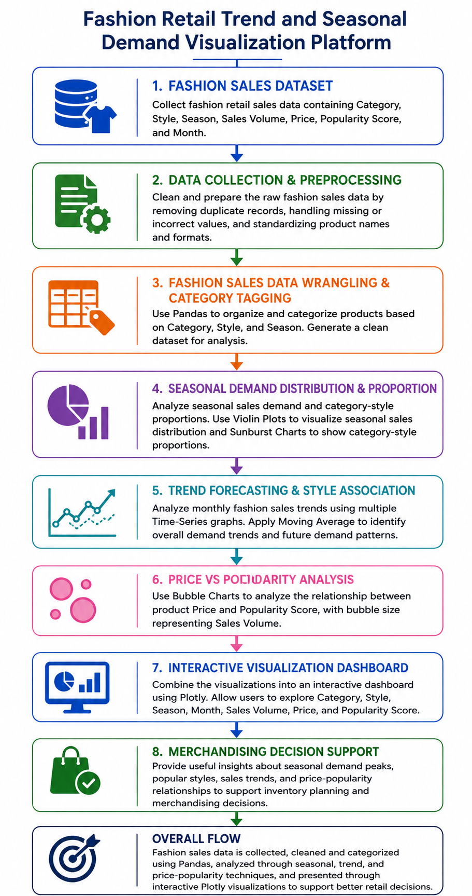
SYSTEM ARCHITECTURE

Slide 7
MODULE 1
Fashion Sales Data Wrangling & Category Tagging
Purpose:
To clean, organize, and categorize fashion sales data so that it can be easily analyzed and visualized.
Key Activities:
1. Data Collection
Collect fashion sales data containing category, style, season, sales volume, price, popularity score, and month.
2. Data Cleaning
Remove duplicate records and handle missing or incorrect values using Pandas
3. Data Organization
Arrange the cleaned data in a proper and consistent format for analysis.
4. Category Tagging
Classify products based on category, style, and season
5. Data Preparation
Prepare the final cleaned and categorized dataset for seasonal analysis, trend forecasting, and price-popularity analysis.
6

Slide 8
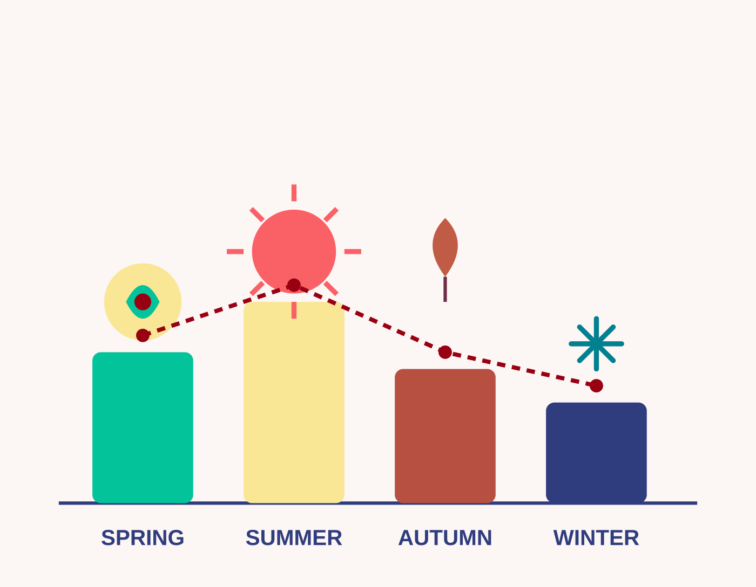
MODULE 2
Seasonal Demand Distribution & Proportion
Purpose:
To analyze seasonal sales demand and understand the proportion of different categories and styles.
1. Analyze Seasonal Sales
Compare sales volume across different seasons such as Spring, Summer, Autumn, and Winter.
2. Create Violin Plots
Use violin plots to visualize the distribution and variation of sales across different seasons.
3. Analyze Category Proportion
Identify how different fashion categories contribute to the overall sales.
4. Analyze Style Proportion
Study how different styles are distributed within each fashion category.
5. Create Sunburst Chart
Use a Sunburst Chart to show the relationship between Category, Style, and their sales proportion.
Sales volume shifts across Spring, Summer,
Autumn, and Winter collections

Slide 9
MODULE 3
Trend Forecasting & Style Association
Purpose:
To analyze fashion demand trends over time, forecast future demand patterns, and study the relationship between price and product popularity.
Key Activities:
1. Analyze Monthly Demand
Study sales volume month by month to identify increasing and decreasing demand patterns.
2. Create Time-Series Visualizations
Use multiple time-series graphs to compare demand trends for different categories and styles.
3. Apply Moving Average
Use Moving Average to smooth sales fluctuations and identify the overall demand trend.
4. Analyze Price vs Popularity
Study the relationship between product price, popularity score, and sales volume.
5. Create Bubble Chart
Use a Bubble Chart to visualize price versus popularity, with bubble size representing sales volume.

Slide 10
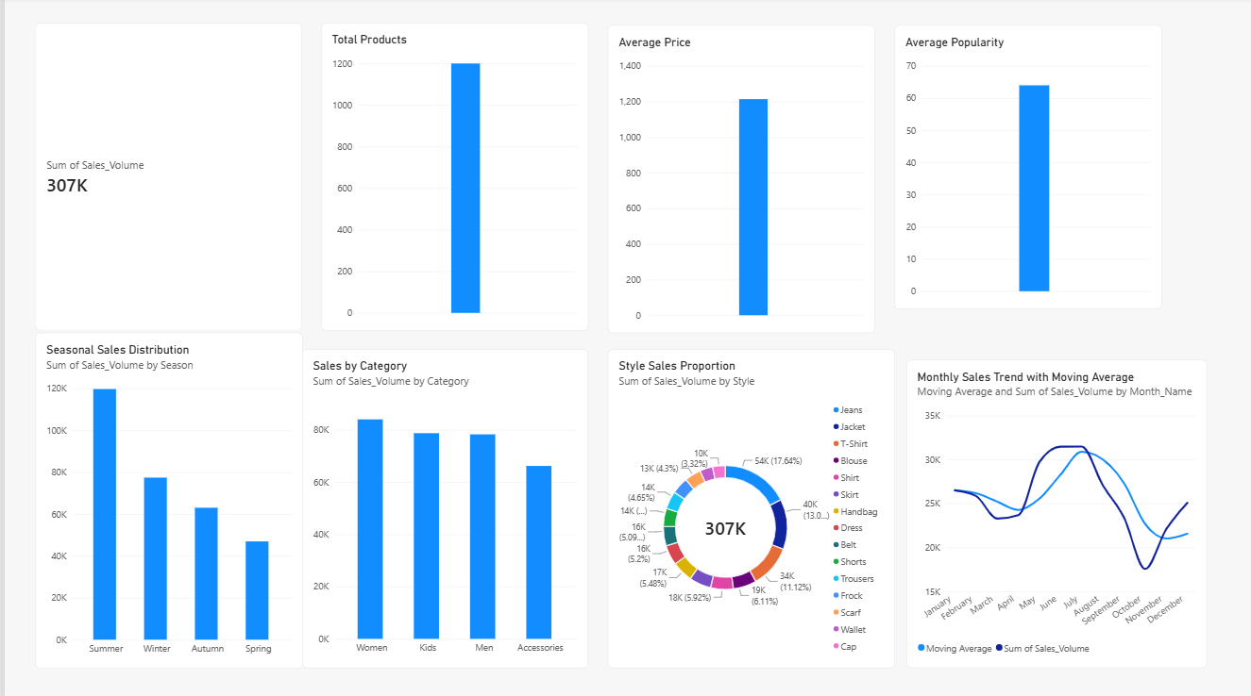
Implementation & Output
Total Sales: Shows the overall sales volume generated from the fashion retail dataset.
Total Products: Shows the total number of products/styles available in the dataset.
Average Price: Shows the average selling price of the products.
Average Popularity: Shows the average popularity score of the products.
Seasonal Sales Distribution: Compares sales performance across different seasons.
Sales by Category: Shows which product categories contribute most to sales.
Style Sales Proportion: Shows the contribution of different styles to total sales.
Monthly Sales Trend with Moving Average: Shows monthly sales trends and uses moving average to identify the overall demand pattern.

Slide 11
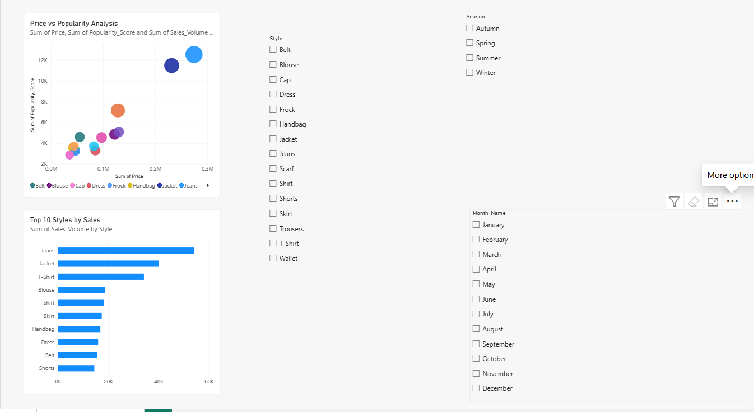
Implementation & Output
Price vs Popularity Analysis: Shows the relationship between product price and popularity.
Top 10 Styles by Sales: Identifies the ten styles with the highest sales volume.
Season Slicer: Allows sales analysis for a selected season.
Month Slicer: Allows filtering the dashboard by month.
Style Slicer: Allows analysis of a selected product style.

Slide 12
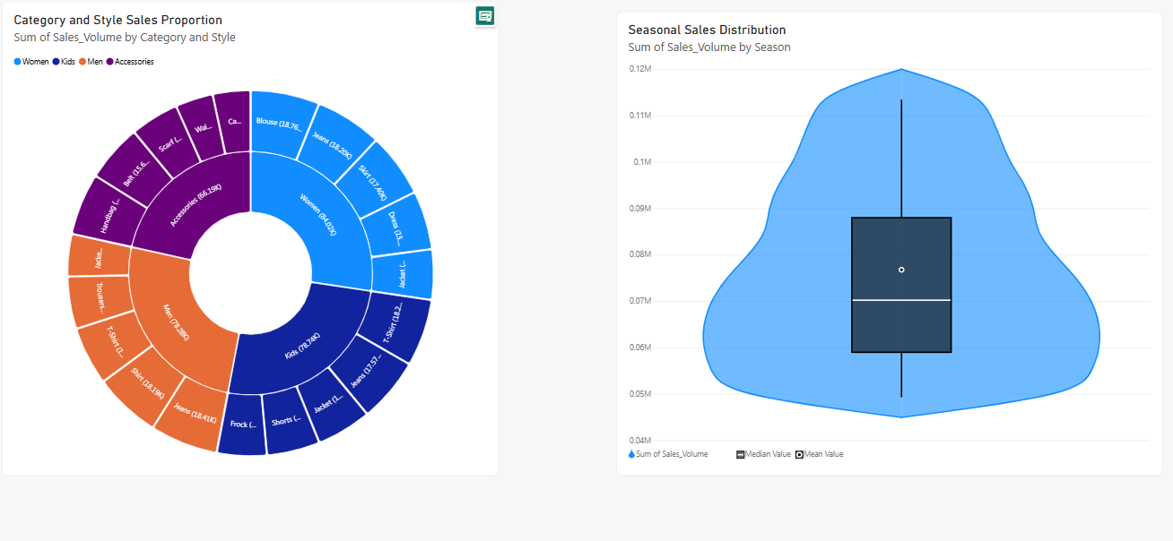
Implementation & Output
Sunburst Chart: Shows the hierarchical relationship between category, style, and sales volume.
Violin Plot — Seasonal Sales Distribution: Shows the distribution and variation of sales volume across different seasons.

Slide 13
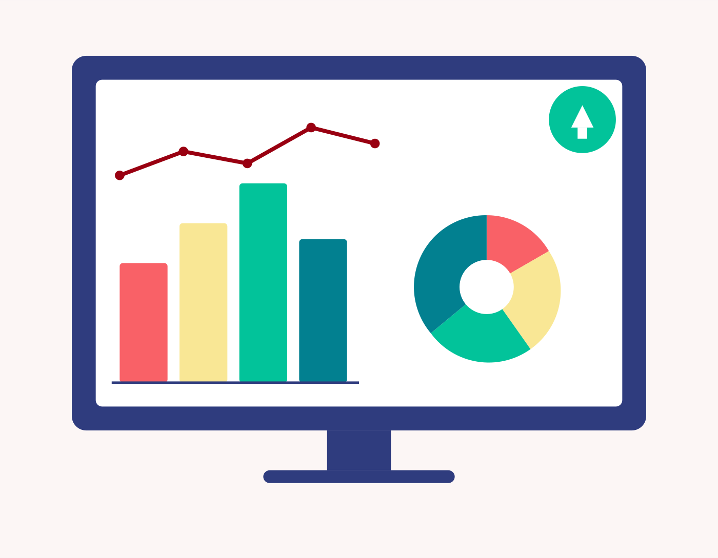
RESULTS AND DISCUSSION
Seasonal Sales Distribution: Violin plots will show how sales volume varies across different seasons and help identify high-demand and low-demand seasons.
Category–Style Proportion: Sunburst charts will show the proportion of different categories and styles and help identify the most important product groups.
Monthly Demand Trends: Multiple time-series graphs will show how sales change month by month for different categories and styles.
Demand Trend Forecasting: Moving Average graphs will smooth sales fluctuations and help identify the overall demand trend and future demand patterns.
Price–Popularity Relationship: Bubble charts will show the relationship between product price and popularity, with bubble size representing sales volume.
Retail Decision Support: The visualizations will help identify seasonal demand peaks, popular styles, demand trends, and price-popularity relationships, supporting better merchandising decisions.
Interactive dashboards turned raw sales data
into clear, actionable insights

Slide 14
ADVANTAGES & APPLICATIONS
ADVANTAGES
Helps understand seasonal demand patterns easily.
Identifies popular fashion categories and styles.
Makes large sales data easier to understand through visualizations.
Helps identify sales trends and future demand patterns.
Shows the relationship between product price and popularity.
Supports better inventory and merchandising decisions.
APPLICATIONS
Fashion retail stores.
Online fashion and e-commerce platforms.
Clothing and apparel brands.
Fashion inventory management.
Sales and demand analysis.
Merchandising and product planning.

Slide 15
FUTURE ENHANCEMENTS
Implement Artificial Intelligence to improve fashion trend prediction.
Apply Machine Learning algorithms to achieve more accurate demand forecasting.
Develop a real-time dashboard to monitor live sales and changing customer demand.
Add a personalized recommendation system to suggest products based on customer preferences.
Connect the platform with cloud databases for storing and analyzing large amounts of fashion sales data.
Develop a mobile application so retailers can easily access sales trends and business insights.

Slide 16
CONCLUSION
The project converts raw fashion sales data into meaningful and easy-to-understand insights.
Fashion products are categorized based on category, style, and season for better analysis.
Seasonal demand patterns can be identified using data visualization techniques.
Monthly sales trends can be analyzed and future demand can be estimated using Moving Average.
Price and popularity relationships can be studied to understand customer preferences.
The platform helps retailers make better decisions related to merchandising, inventory planning, and product selection.
12

Slide 17
REFERENCES
Koren, M., Perlman, Y., & Shnaiderman, M. (2026). Unveiling the power of social networks in demand prediction for substitutable fashion products. International Journal of Fashion Design, Technology and Education, 1-12.
Abeysooriya, R. P., Dahanayake Yapa, T. S., & Mataraarachchi, R. (2026). From rule to intelligence: a review of algorithmic heuristics in fashion retailing. Journal of Fashion Marketing and Management: An International Journal, 1-26.
Kayode, O., Luz, A., & Herry, J. (2025). Predictive Analytics for Demand Forecasting in Ethical Fashion: Bridging Sustainability and Smart Technology.
Castro, I., & do Amaral, I. (2025, November). The Use of AI in Fashion Industry for Trend Forecasting: An Introduction to the Literature Review. In International Conference on Design and Digital Communication (pp. 189-201). Cham: Springer Nature Switzerland.
Kayode, O., Luz, A., & Herry, J. (2025). Predictive Analytics for Demand Forecasting in Ethical Fashion: Bridging Sustainability and Smart Technology.

Slide 18
THANK YOU!!

